Slide 1
Data science en mi vida
Luisa Fernanda castro

Slide 2


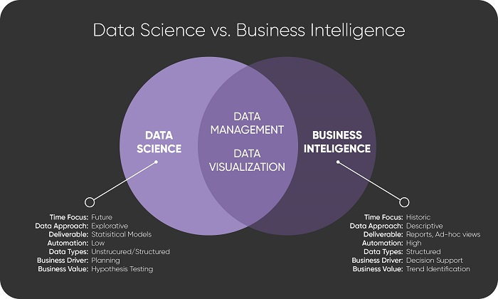

Slide 3


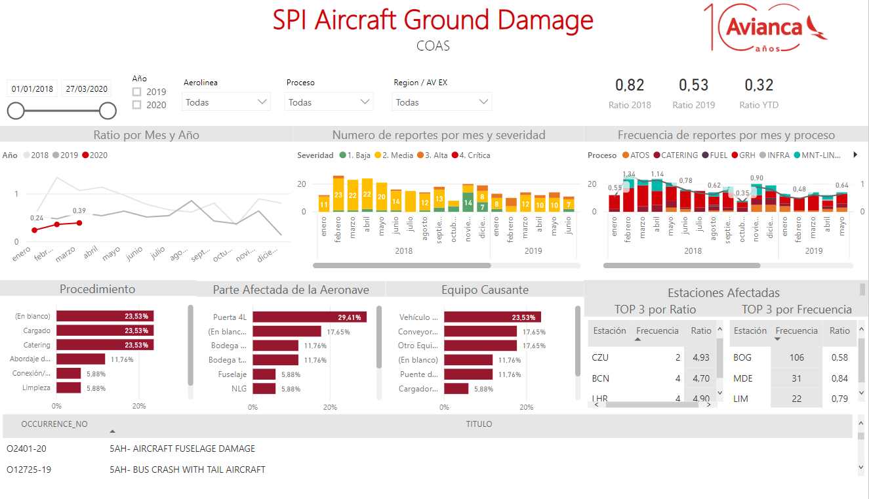
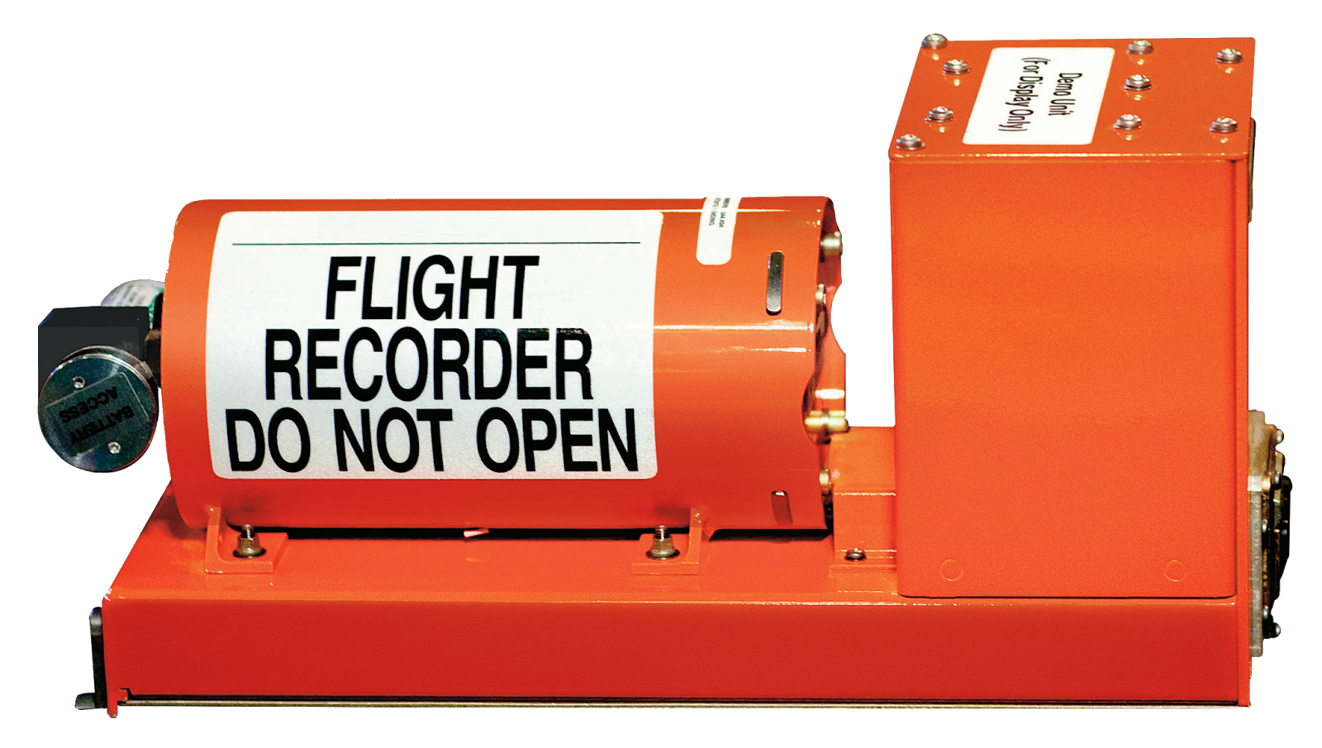
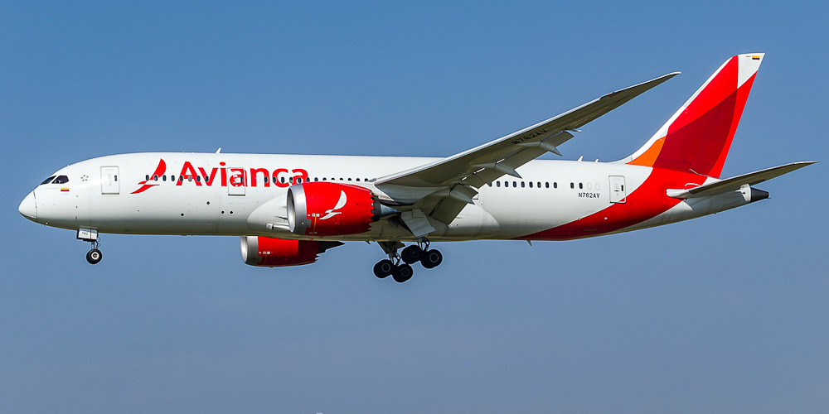
Identificación de Problemas a través de Dashboards
Fuentes de Información
Reportes de personas de la organización y terceros sobre problemas de seguridad operacional.
(Descripción del Problema, Origen, Destino, Aeronave)
Datos grabados por las aeronaves. (ej Velocidad, Altura, Parámetros de Motores)
Vuelos operados.
(Origen,Destino,Aeronave)

Slide 4
Relacionar diferentes fuentes de datos
Predicción
Planeación
Eficiencia
Seguridad
Identificación del Problema
PROBABILITY FUNCTION
PROBABILITY FUNCTION
Adquisición de fuentes de datos
útiles
DATA SCIENCE
Experiencia del personal
Capacitaciones del Personal
Meteorología
Costos por incidentes
Historial de las aeronaves

Slide 5




When the co-pilots became captains, they did not have the experience and expertise to perform their new functions as captains without any restriction
In our company there were a lot of flight restrictions for co-pilots.
PROBLEM FRAMING
This safety study allowed us to relate the number of events that occur in our airline based on the experience of a co-pilot in order to remove all restrictions to a co-pilot before he becomes a captain.
Approach / landing with crosswind up to 10 knots on wet runway.
Taxi in / Taxi out
Approach / landing with visibility up to CAT I minimums.

Slide 6
Curva de Aprendizaje
Numero de eventos
Horas de Experiencia

